Slide 1
Teacher Resource Bank
by Jessica A. Lemmo

Slide 2
Purpose:
The teacher’s resource bank will provide books, media, pathfinders, etc that will help the teachers enhance their lessons based upon the curriculum.
Teachers were in a need of resources to use within the classroom – so I compiled the above items from personal supply or donation so that teachers could use these items to promote student growth in the classroom

Slide 3
Items for resource bank:
Audio-Visual Inventory
Pathfinders
Open Research Times
Assignment Alerts
Request forms
Teacher books related to themes, testing, etc.
Professional Books
DVDs, VHS & Software

Slide 4
Information sheets – Request Forms:
Area of Study
Library Research Time
Audio-Visual
Teacher Information Letter
Collaboration Time

Slide 5
Procedure and Policies:
Teachers will be able to check out resources to use to make copies, read, etc.
Teachers will be provided with a Audio-Visual Inventory that is broken into subjects
Teachers are to fill out appropriate forms for research, assignments, etc and return to the library according to the timeline (most items are due at least 1 week before hand)

Slide 6
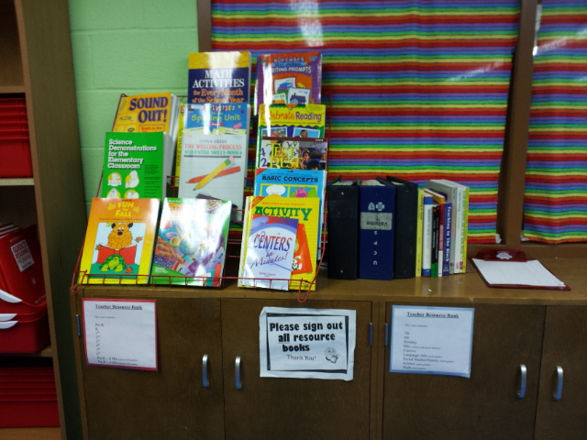
Seasonal Books, Professional Books & Sign Out Sheet

Slide 7
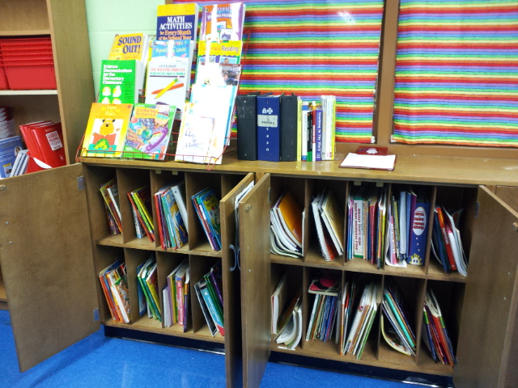
Cubbies separated by grade level and subject matter

Slide 8
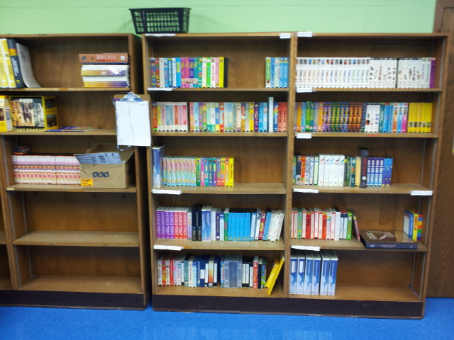
Media- Software, VHS & DVDs separated by subject matter

